Slide 1
Accessing Database with Python

Slide 2
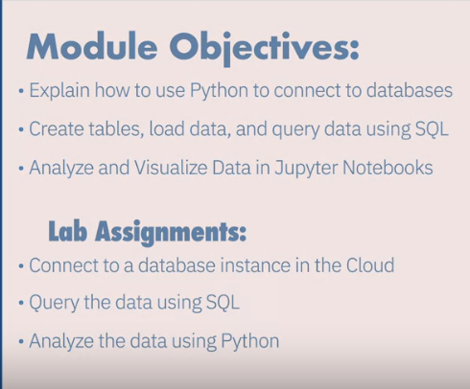
Row retrival using string pattern
A notebook interface is a virtual notebook environment used for programming.
Examples of notebook interfaces include the Mathematica notebook, Maple worksheet, Matlab notebook, IPython Jupyter, R Markdown, Apache Zeppelin, Apache Spark notebook, and the Databricks cloud
Jupyter Notebook support for over 40 programming languages including Python, R, Julia, and Scala.
Notebooks can be shared with others by email, Dropbox, GitHub, and the Jupyter notebook viewer.
Your code can produce rich interactive output HTML, images, videos, LaTex, and customized types.
You can leverage big data tools such as Apache Spark from Python, R, and Scala, and explore that same data with pandas, scikit-learn, ggplot2, and TensorFlow.

Slide 3
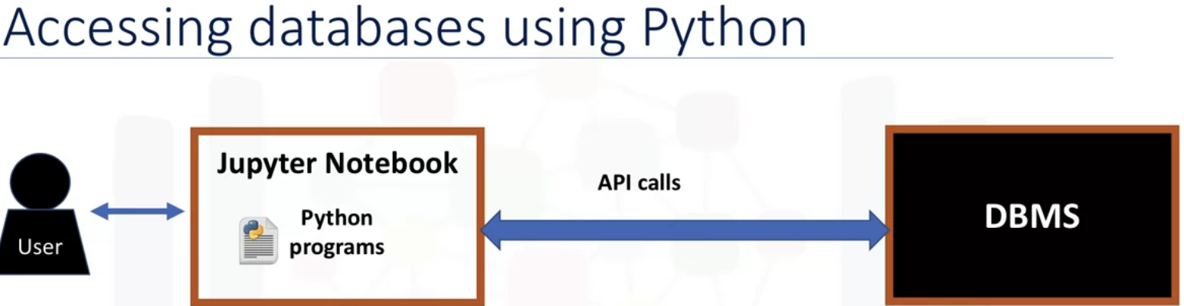
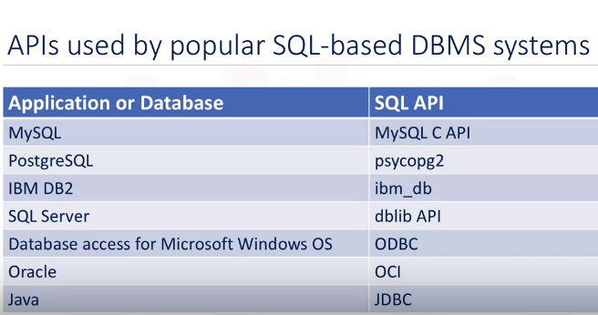
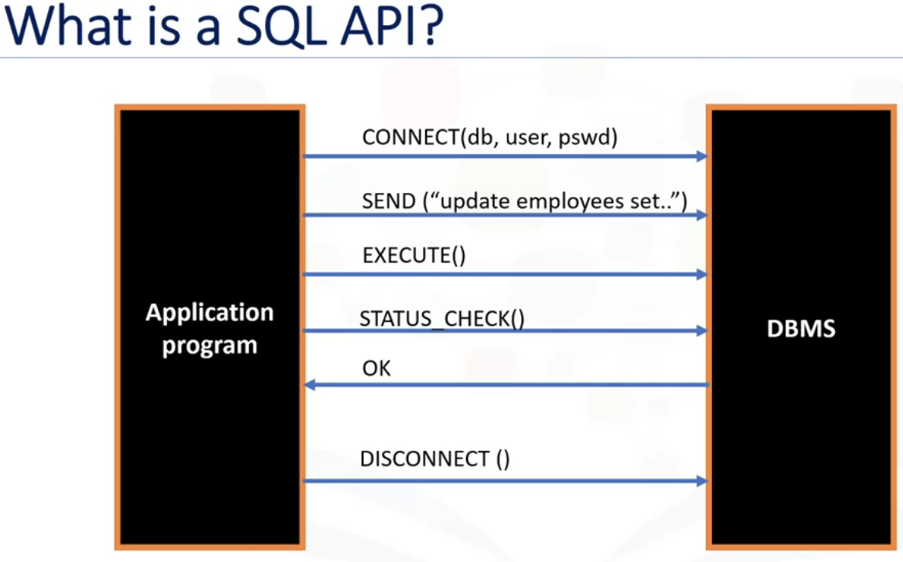

Slide 4
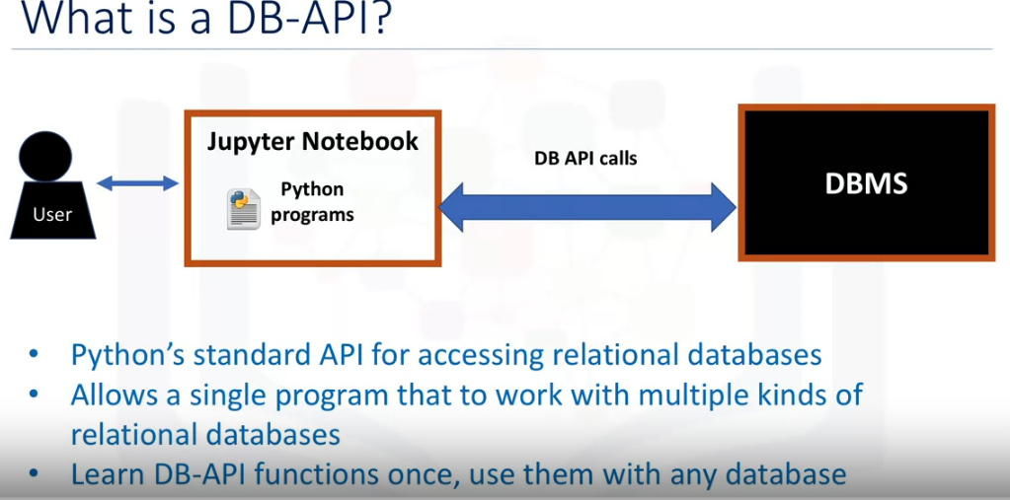
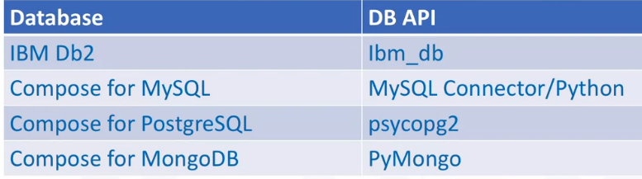
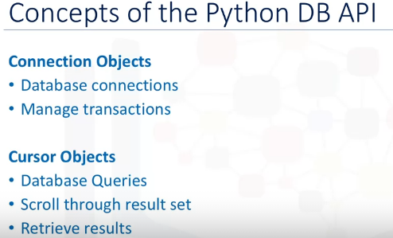
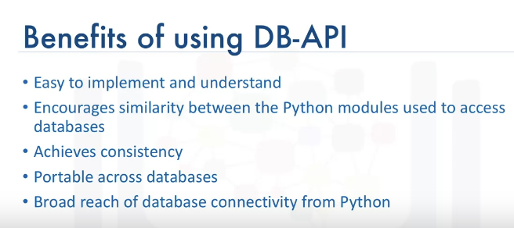

Slide 5
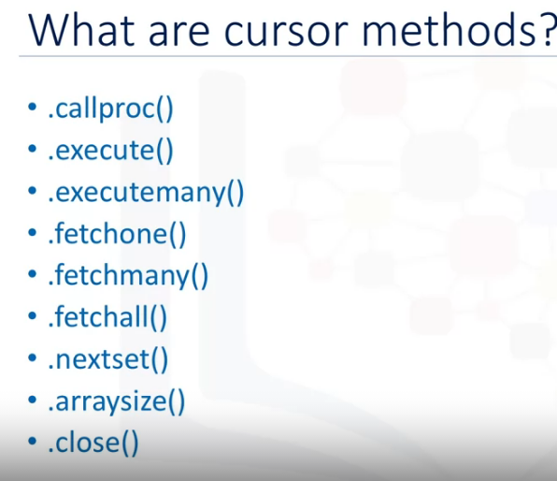
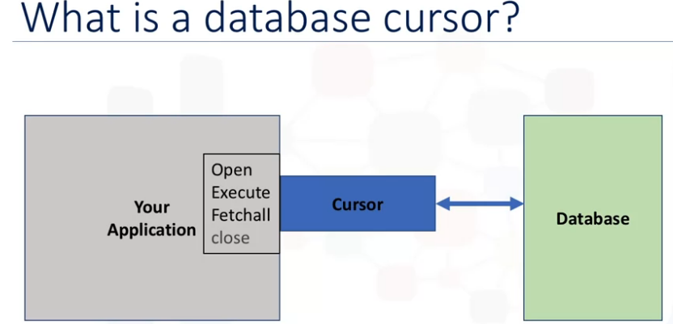
Connection Methods:
.Cursor() : returns a new cursor object using the connection.
.commit() : used to commit any pending transaction to the database.
.rollback() : causes the database to roll back to the start of any pending transaction
.close() : used to close a database connection.
A database cursor is a control structure that enables traversal over the records in a database. I
t behaves like a file name or file handle in a programming language. Just as a program opens a file to access its contents, it opens a cursor to gain access to the query results.
Similarly, the program closes a file to end its access and closes a cursor to end access to the query results.
Cursors created from different connections can or cannot be
isolated depending on how the transaction support is implemented.

Slide 6
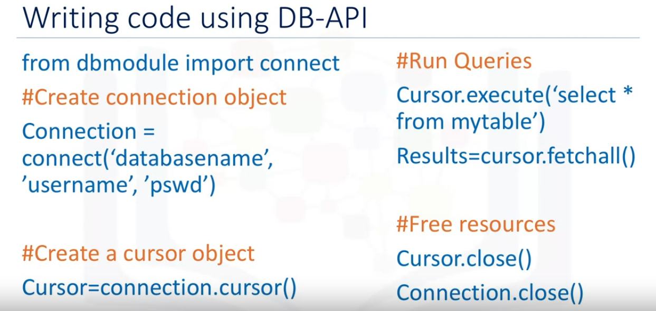
Let's walk through a Python application that uses the DB-API to query a database.
First, you import your database module by using the connect API from that module. To open a connection to the database, you use the connect constructor and pass in the parameters, that is, the database name, username, and password. The connect function returns connection object. After this, you create a cursor object on the connection object. The cursor is used to run queries and fetch results.
After running the queries, using the cursor, we also use the cursor to fetch the results of the query. Finally, when the system is done running the queries, it frees all resources by closing the connection. Remember that it is always important to close connections to avoid unused connections taking up resources.

Slide 7
Connecting to a database using ibm_db API

Slide 8
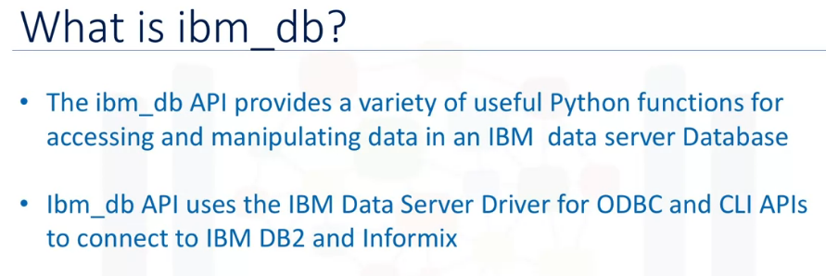
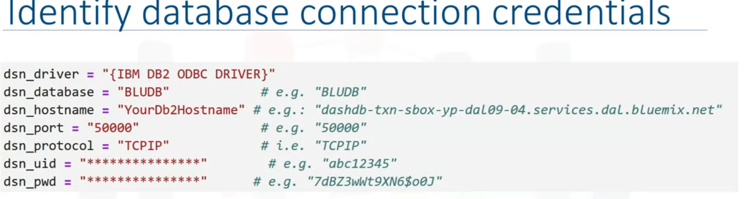
Connecting to the DB2 requires the following information:

Slide 9
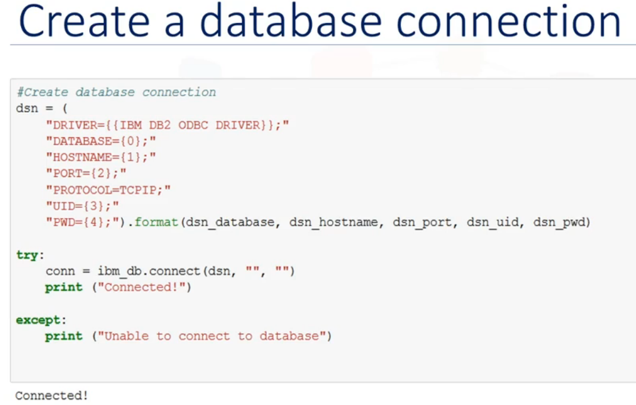
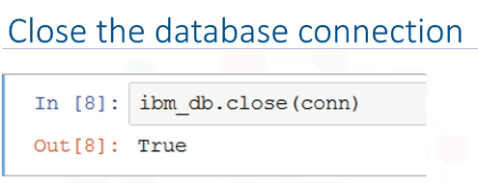
We create a connection object DSN, which stores the connection credentials.
The connect function of the ibm_db API will be used to create a non persistent connection.
The DSN object is passed as a parameter to the connection function.
If a connection has been established with the database, then the code returns connected, as the output otherwise, the output will be unable to connect to database.
Then we free all resources by closing the connection.

Slide 10
Creating tables, loading data and querying data

Slide 11
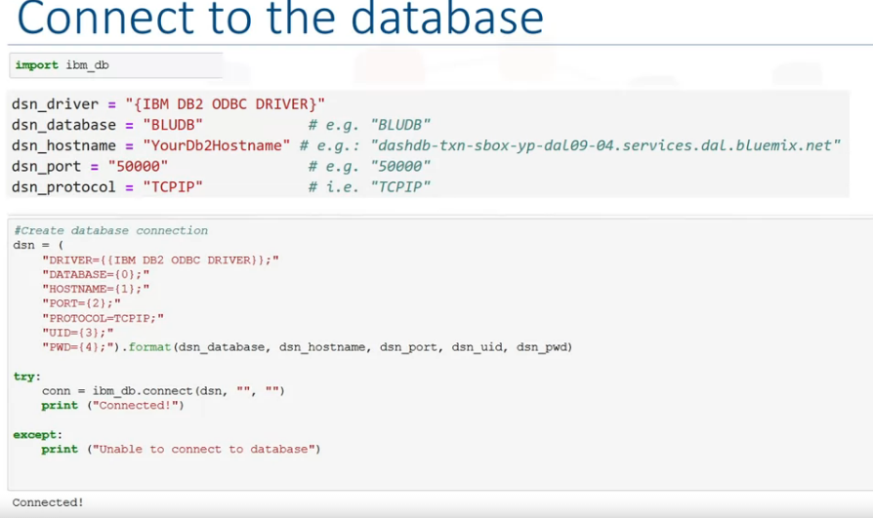

Slide 12
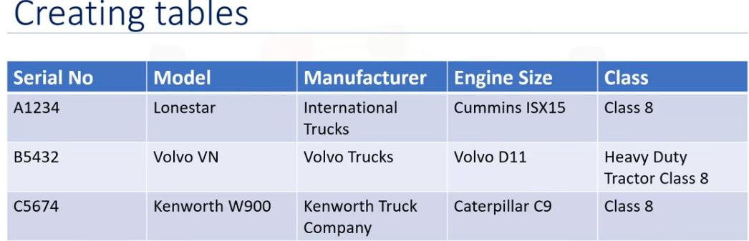
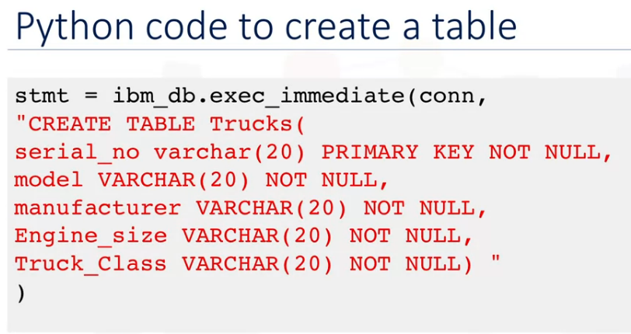
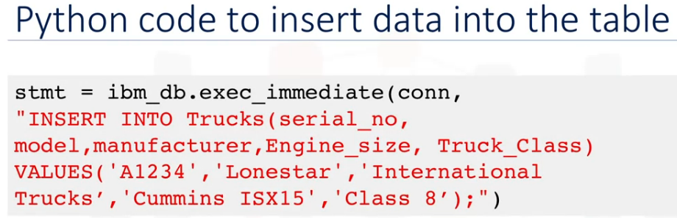
There are different ways of creating tables in DB2. One is using the Web console provided by DB2,
and the other option is to create tables from any SQL, R, or Python environments.
For example, we need to create this Trucks table in
Database using python.
It would be executed with ibm_db.exec_immediate( )
function.
parameters : Connection, Statement and Options

Slide 13
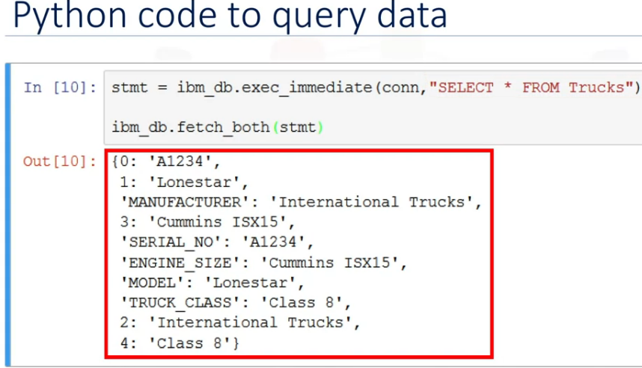
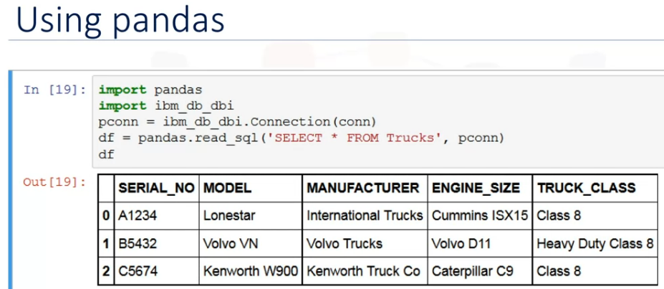
We can use, python code for connecting database and
querying data.
We can also use Pandas DataFrame for the same.

Slide 14
Analyzing data with Python

Slide 15
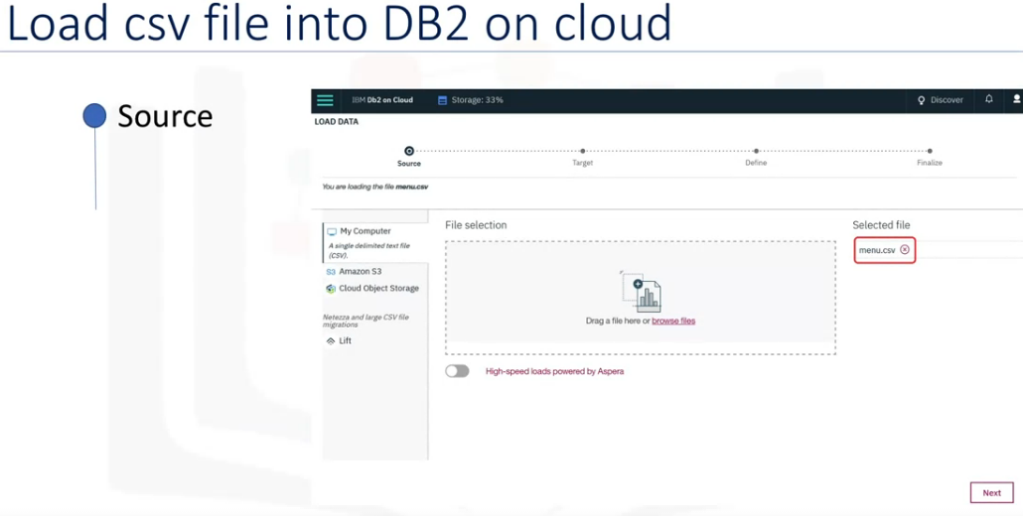
Loading data (csv file) into DB2 on cloud
Source > Target > Define > Finalize

Slide 16
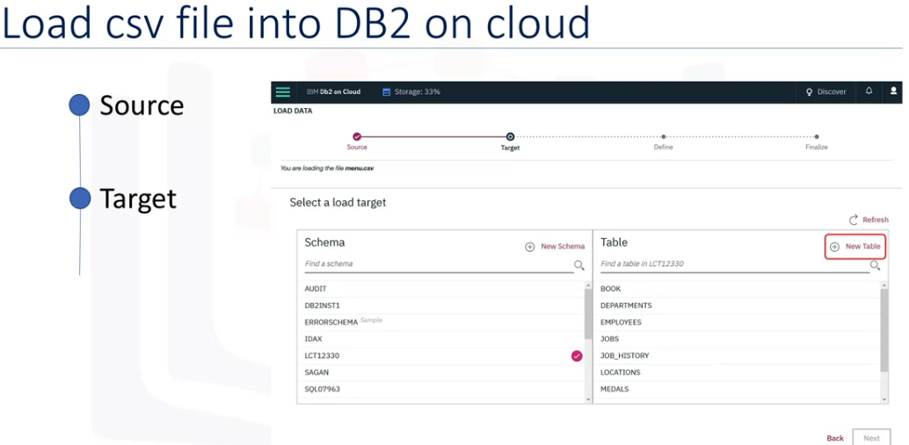

Slide 17
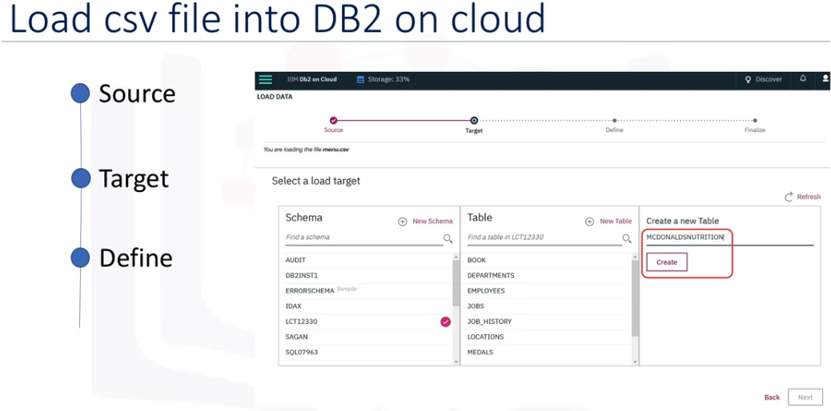

Slide 18
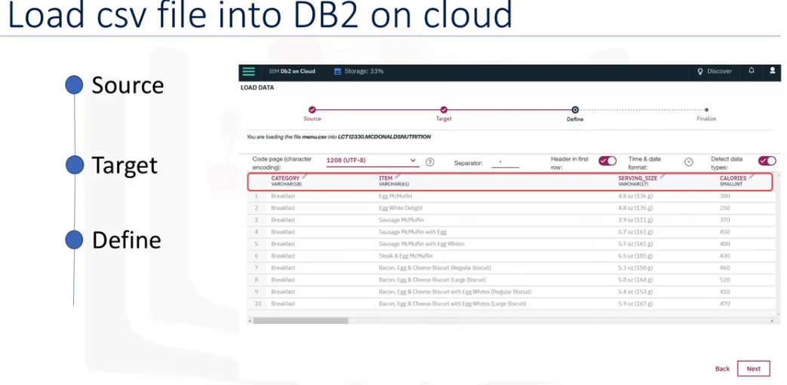

Slide 19
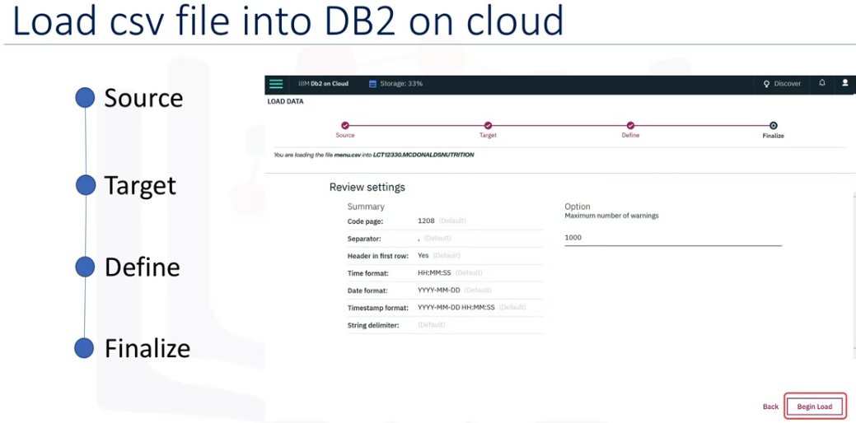

Slide 20
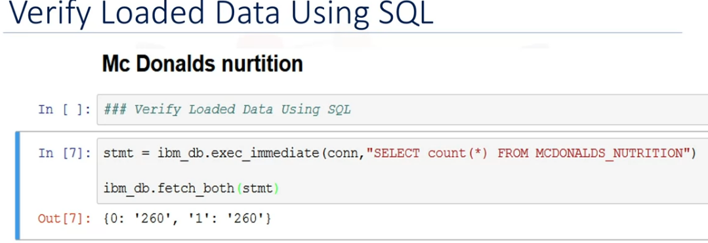
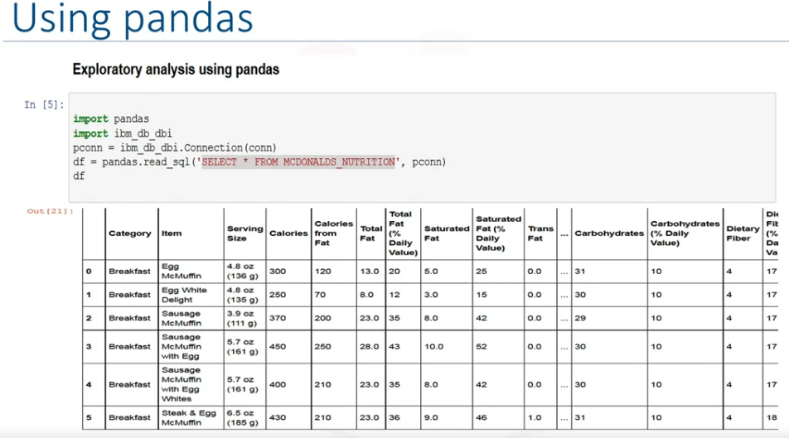
After loading data from csv file into DB2 database,
We can query data using Python.
We can also retrieve data using Pandas
DataFrame.

Slide 21
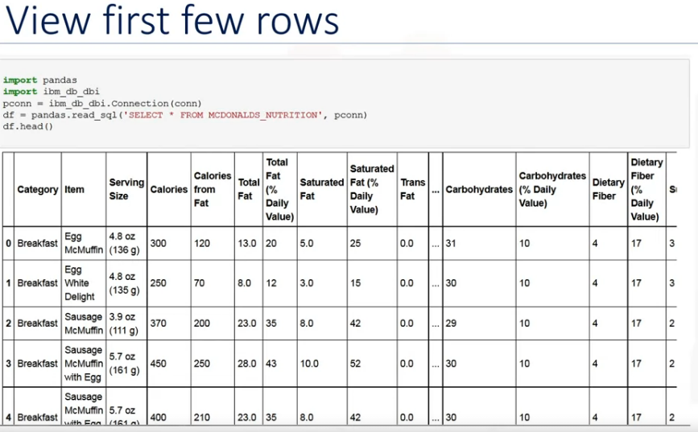
df.head( ) to explore first few rows

Slide 22
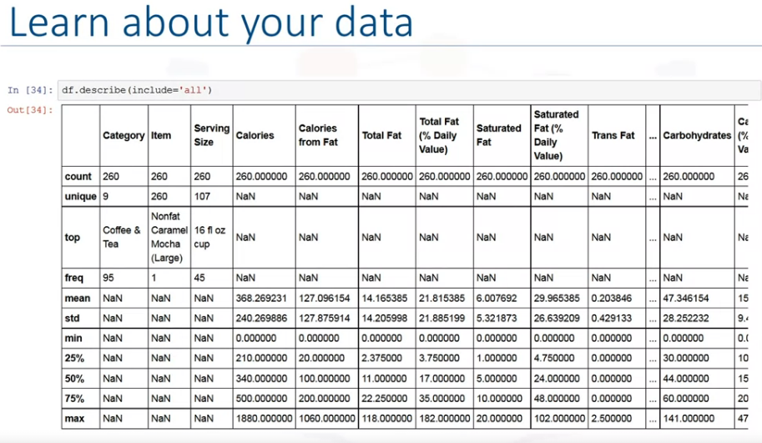
df.describe( ) to explore count, unique, min, max, avg

Slide 23

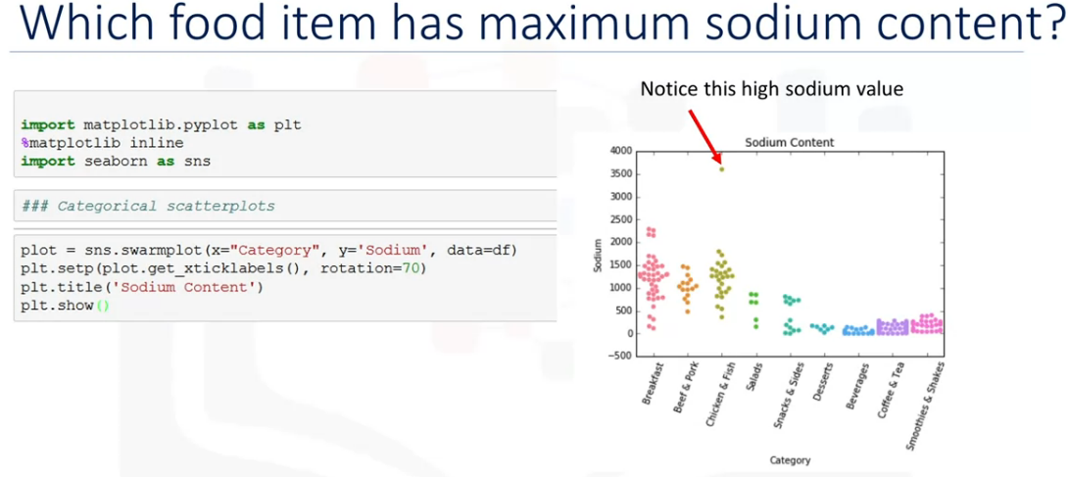
Swarmplot

Slide 24
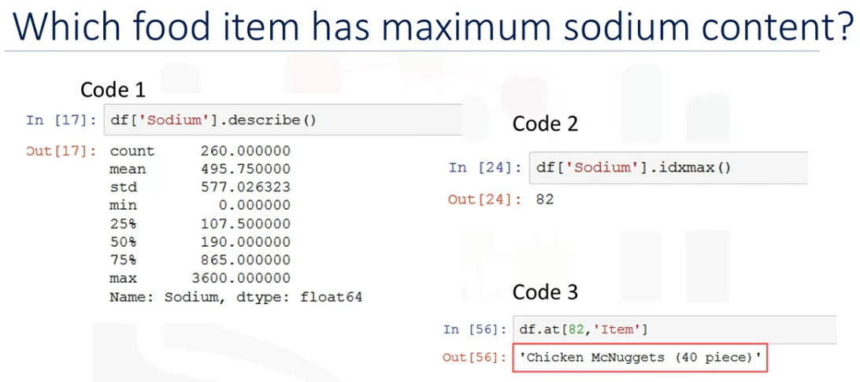
Maximun index value of sodium is 82.
Checking the 82nd item in the df : Nuggets

Slide 25
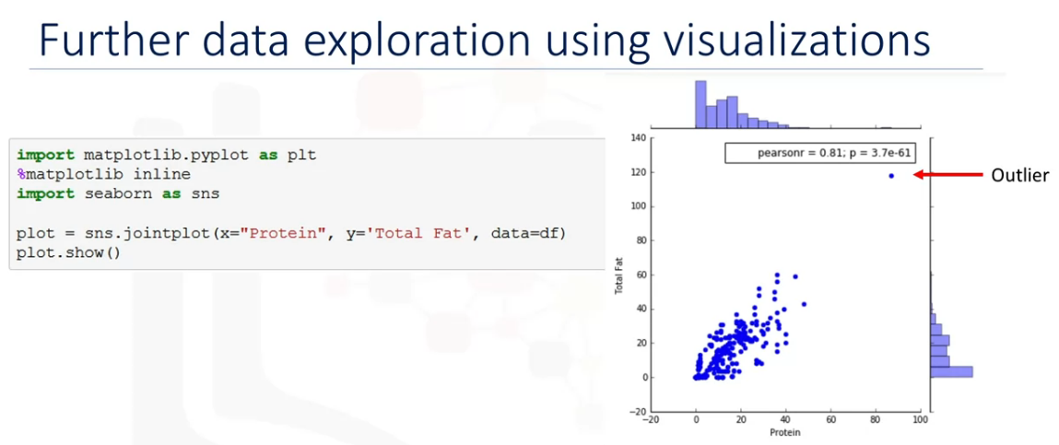
Jointplot

Slide 26
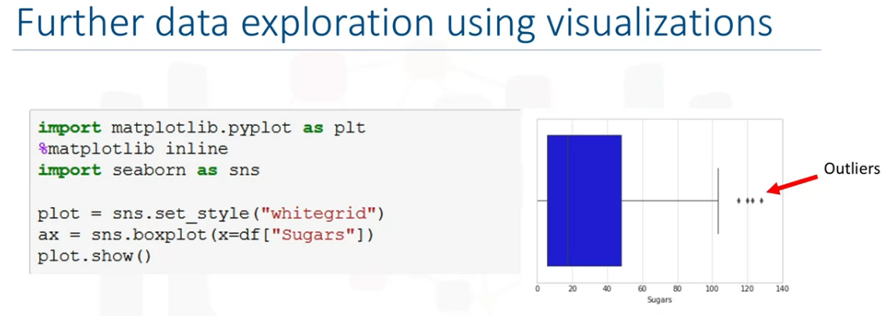
BOXplot
There are outliers that are beyond 100gms of sugar level, candies might be the items as outliers.

Slide 27
Summary & Highlights
You can access a database from a language like Python by using the appropriate API. Examples include ibm_db API for IBM DB2, psycopg2 for ProstgreSQL, and dblib API for SQL Server.
DB-API is Python's standard API for accessing relational databases. It allows you to write a single program that works with multiple kinds of relational databases instead of writing a separate program for each one.
The DB_API connect constructor creates a connection to the database and returns a Connection Object, which is then used by the various connection methods.
The connection methods are:
The cursor() method, which returns a new cursor object using the connection.
The commit() method, which is used to commit any pending transaction to the database.
The rollback() method, which causes the database to roll-back to the start of any pending transaction.
The close() method, which is used to close a database connection.
You can use SQL Magic commands to execute queries more easily from Jupyter Notebooks.
Magic commands have the general format %sql select * from tablename.
Cell magics start with a double %% (percent) sign and apply to the entire cell.
Line magics start with a single % (percent) sign and apply to a particular line in a cell.

Slide 28
port : 30426
db : "bludb"
host : "125f9f61-9715-46f9-9399c8177b21803b.c1ogj3sd0tgtu0lqde00.databases.appdomain.cloud"
username :
password :
"password": "kmF1hR135O9N4QTe", "username": "zqt97360"

Slide 29
Working with real-World Datasets

Slide 30
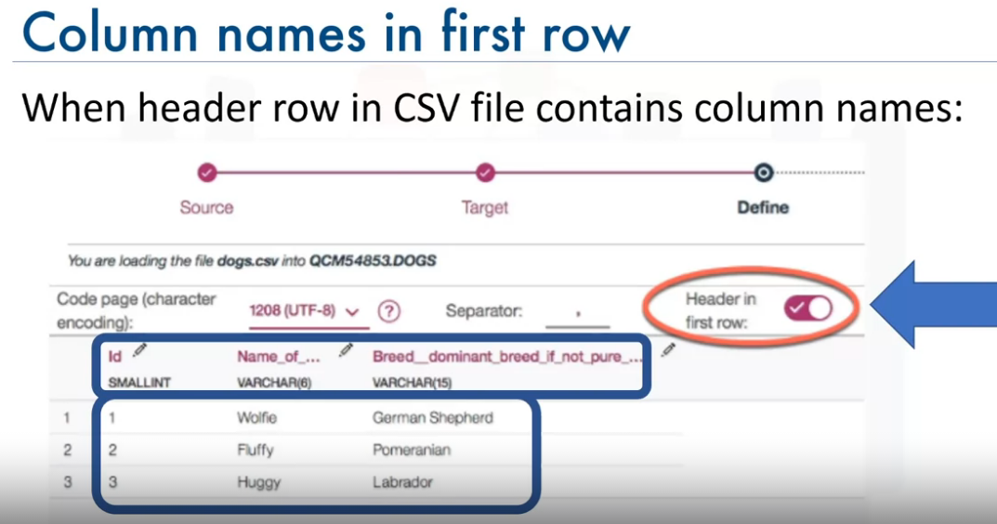
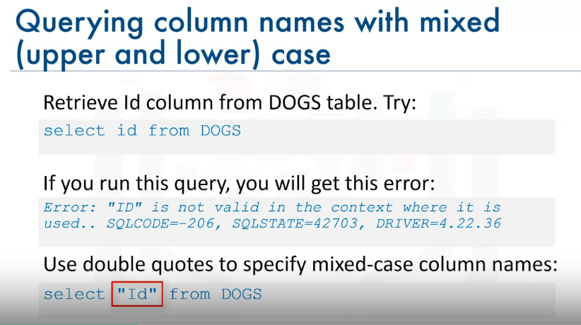

Slide 31
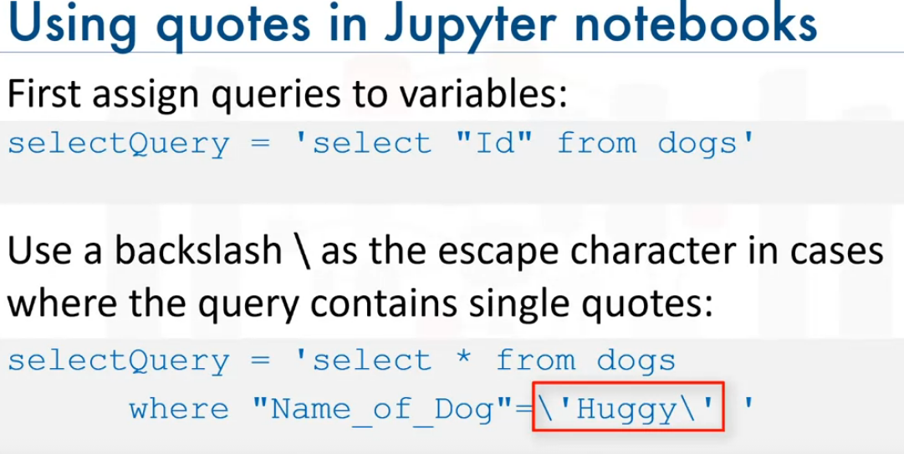
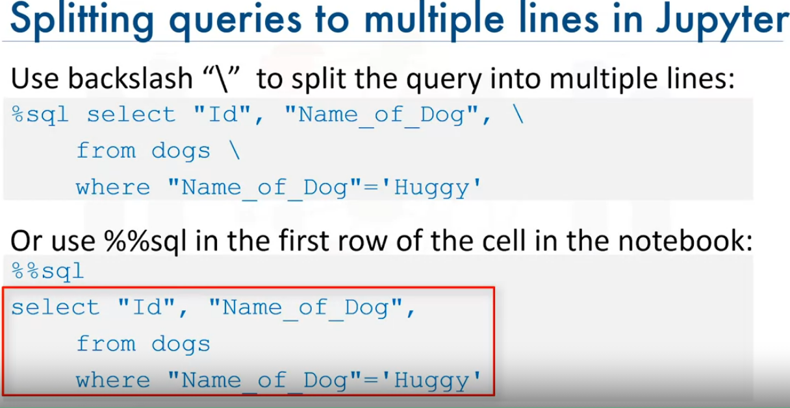
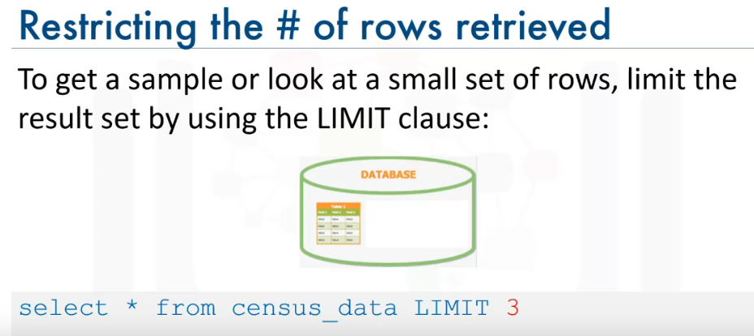

Slide 32
Getting Tables & Column Details

Slide 33
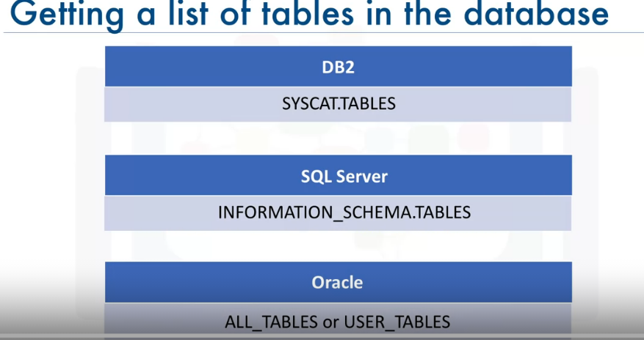
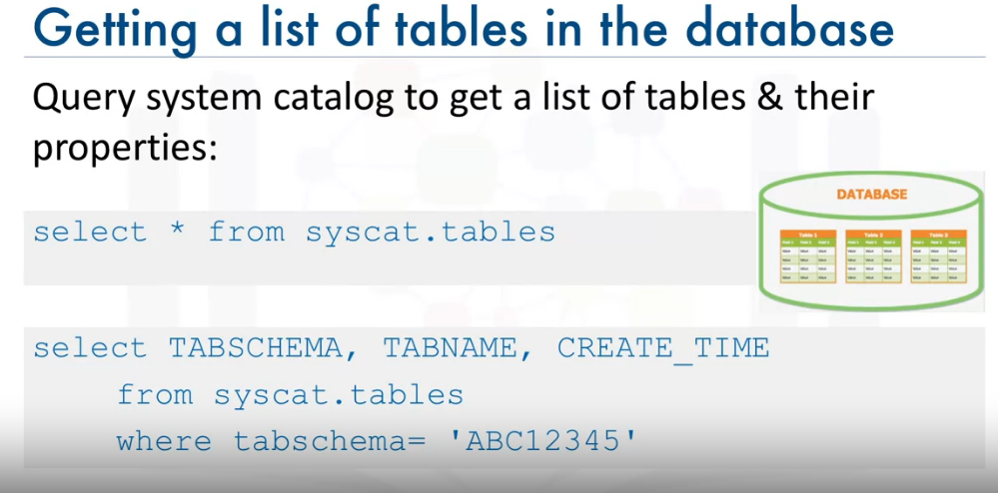
How to get list of tables & their Properties?
DB2

Slide 34
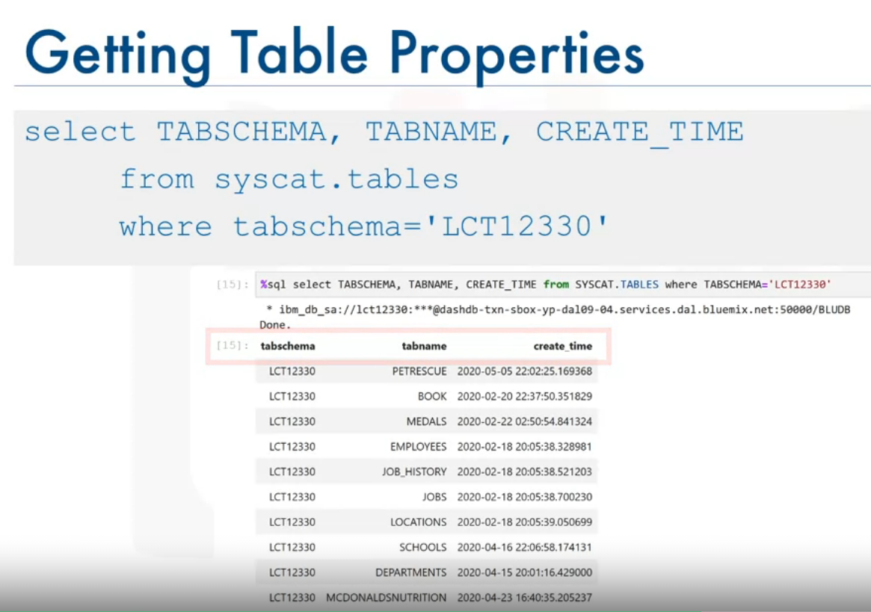
How to find the most recent table created in the database?

Slide 35
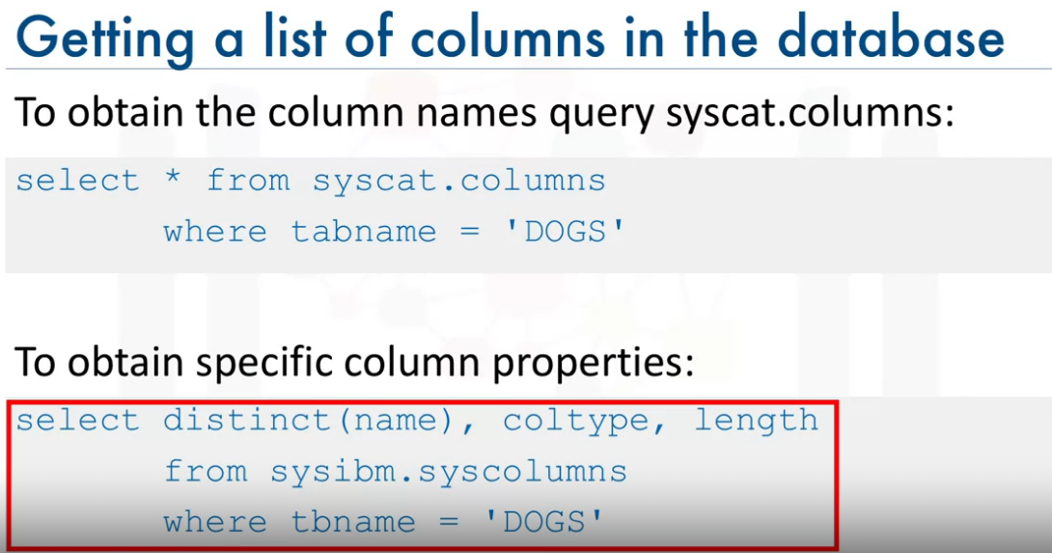

Slide 36
